Slide 1
MODULE-4
BCSE306
Artificial Intelligence
Dr.Priyanka N
Assistant Professor Senior Grade-1
School of Computer Science and Engineering (SCOPE),
VIT Vellore,
Priyanka.n@vit.ac.in

Slide 2
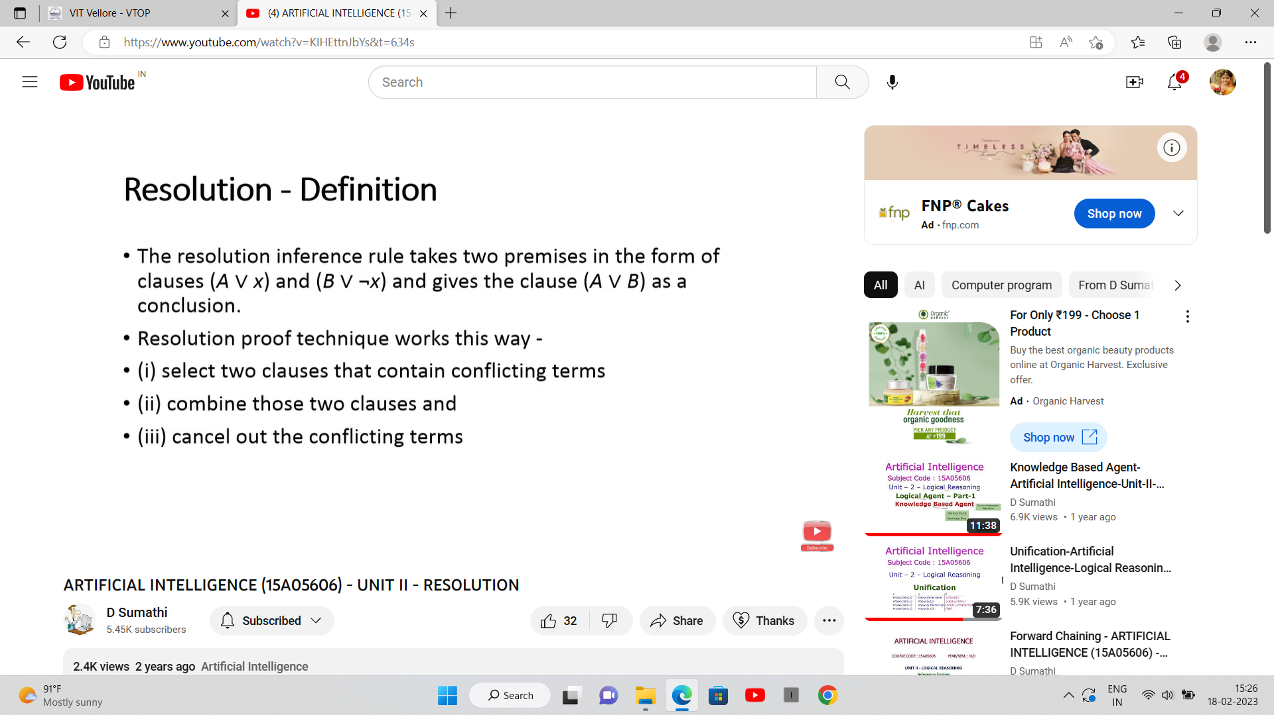

Slide 3
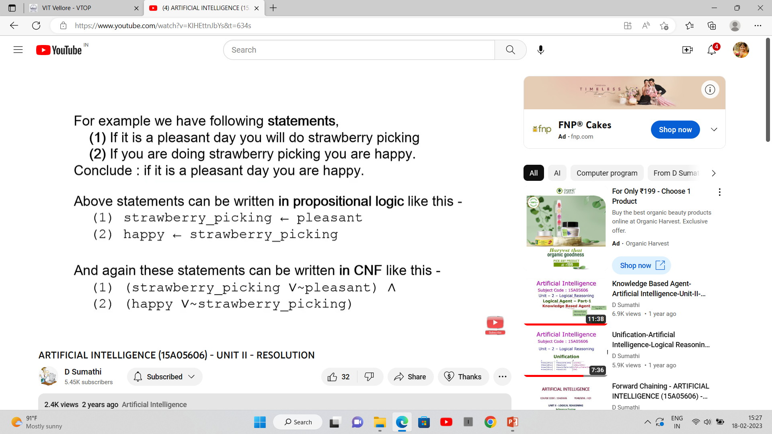

Slide 4
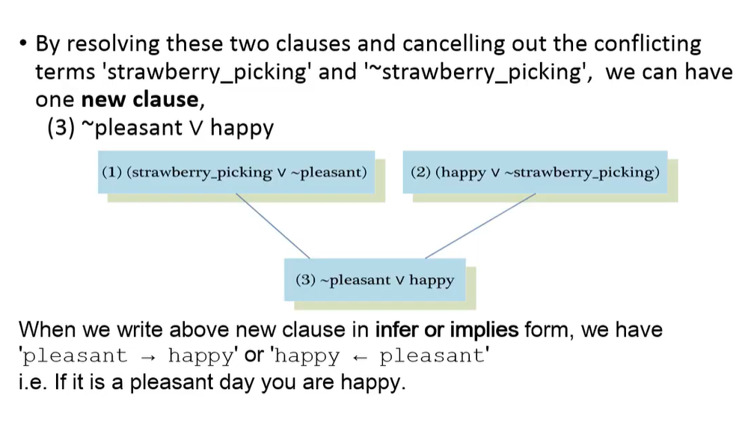

Slide 5
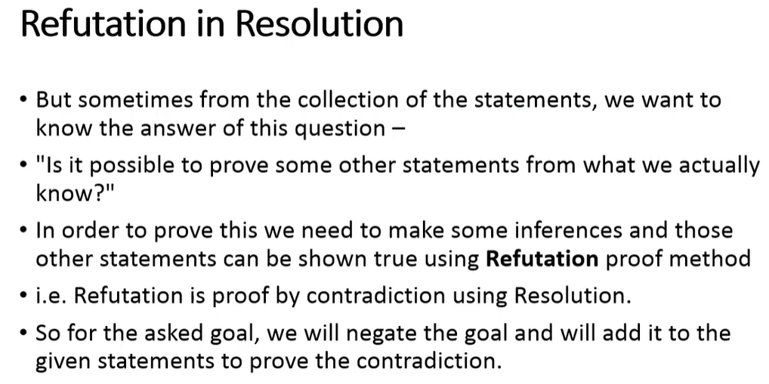


Slide 6
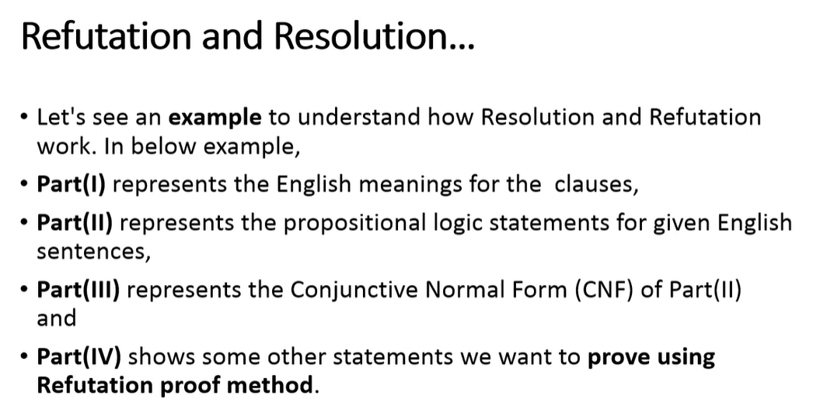

Slide 7
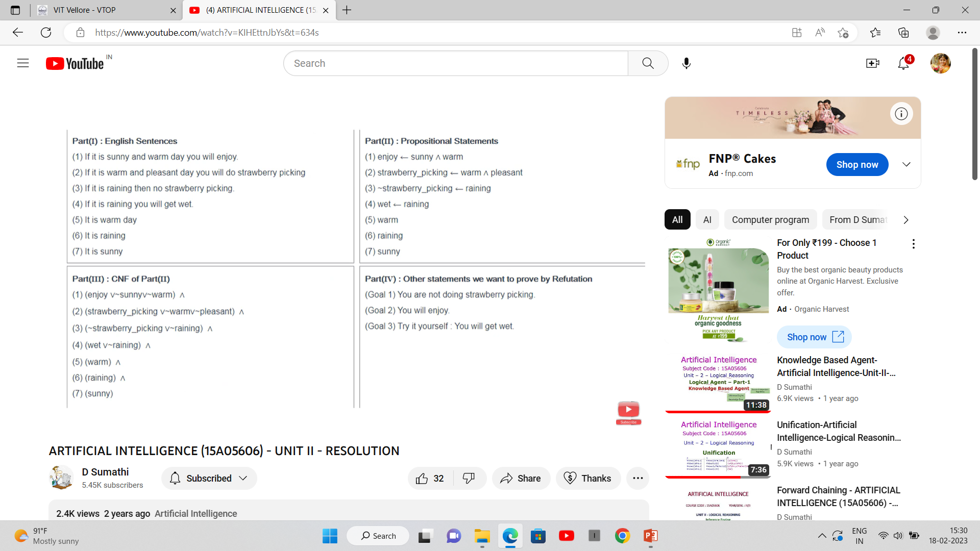

Slide 8
